Slide 1





AI-Enabled Respiratory Risk Forecasting: Leveraging Public IAQ Data and Bioaerosol Signals for Predictive Health Intelligence
Cameron Jones¹,²,³ and Bhavya Raj¹ ¹ Biological Health Services, Australia ² National Institute of Integrative Medicine, Australia ³ BioMedix Co. Ltd., Thailand

Slide 2

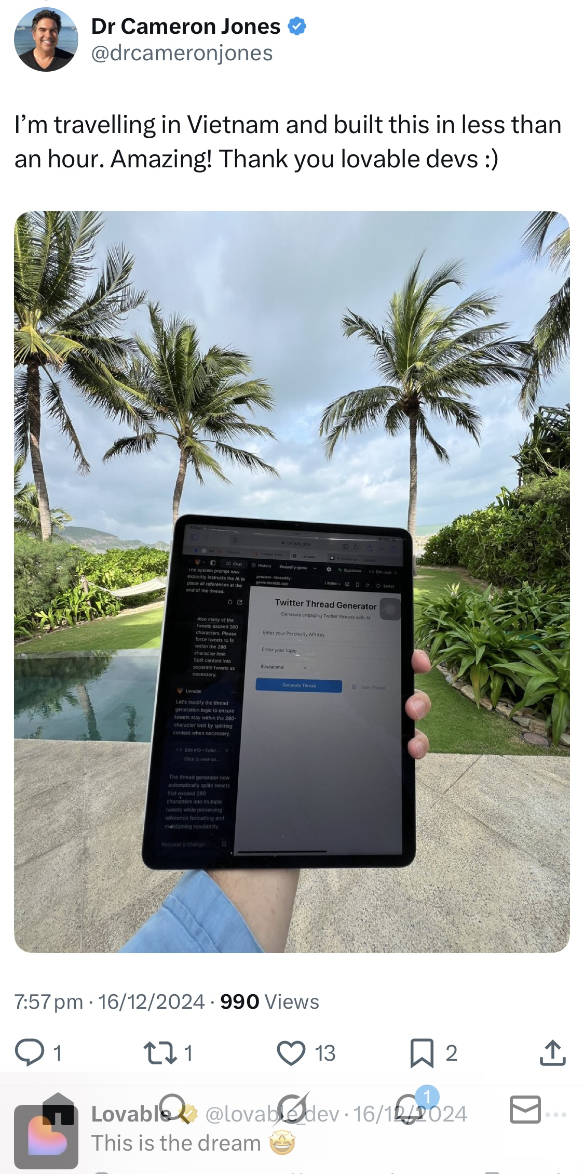

Notes:
How could this be personalised and scaled?

Slide 3
What if you could use AI to predict your asthma risk or your ILI risk?
Notes:
How could this be personalised and scaled?

Slide 4
Where did the science behind this idea come from?
….It evolved from COVID-Era Research on Bioaerosols….
Notes:
The focus is always on using mould spore, PM, pollen to correlate with illness and hospital presentations

Slide 5
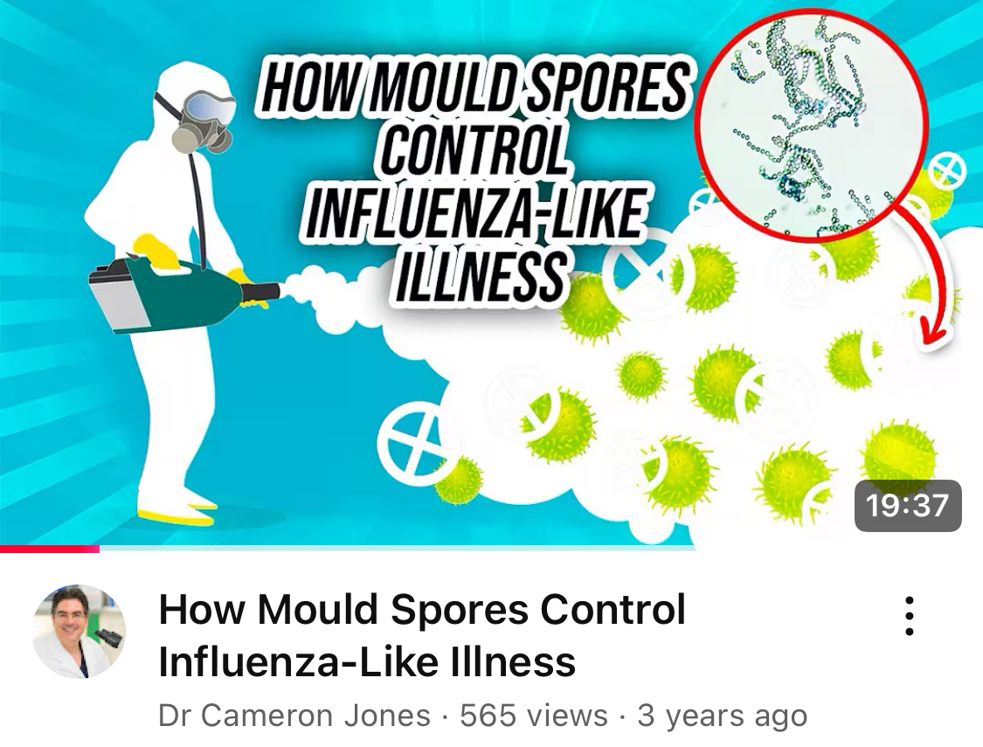
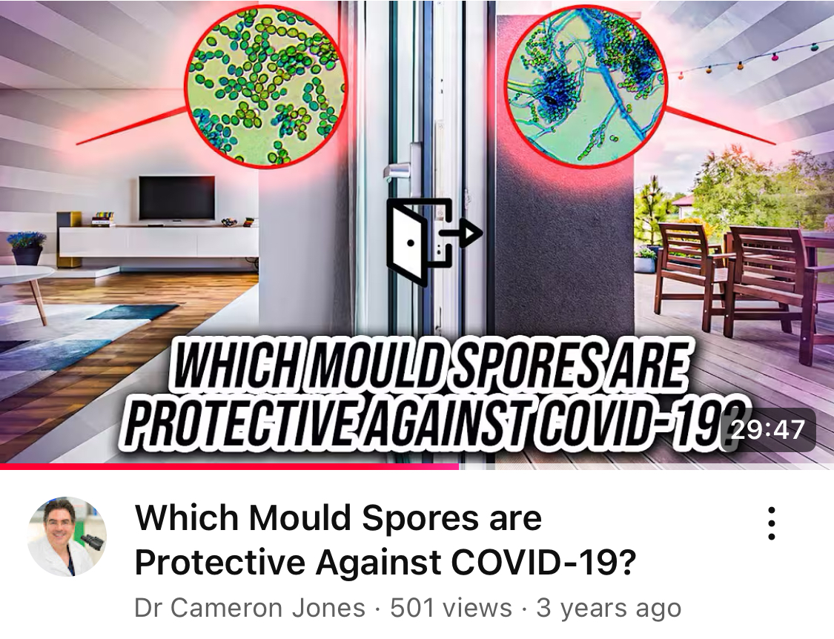
Bioaerosols
https://www.youtube.com/@DrCameronJones
Original Hypothesis During COVID-19 (2020-2021)

Slide 6
Bioaerosols
Original Hypothesis During COVID-19 (2020-2021)
Grounded in hygiene hypothesis: Exposure to non-pathogenic bioaerosols (e.g., mould spores, pollen) may condition immune responses and inversely correlate with respiratory viruses like influenza-like illnesses (ILIs) and COVID-19.

Slide 7
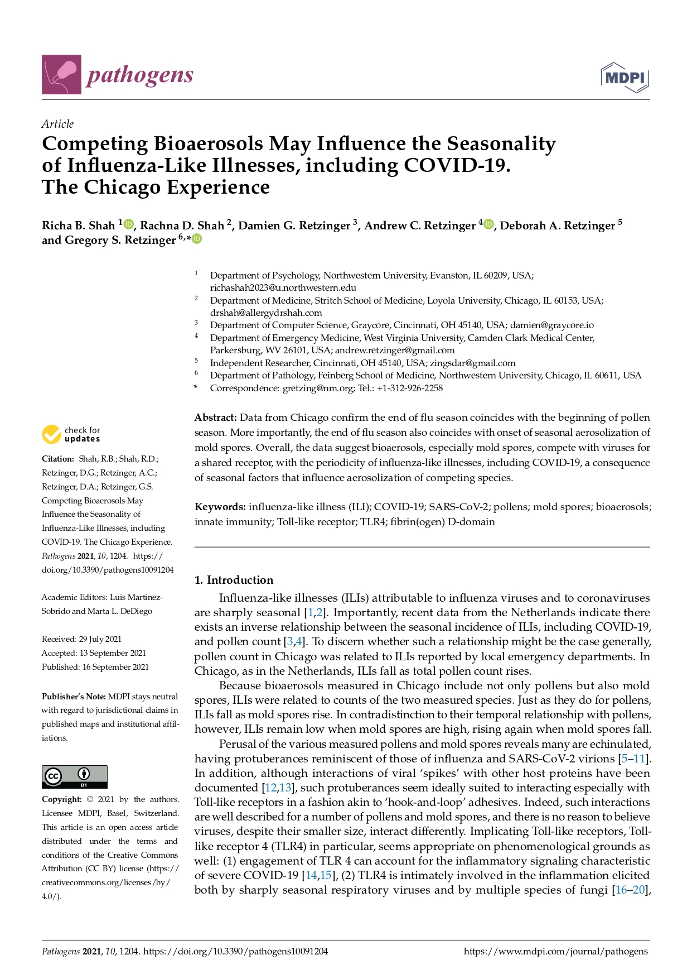
Bioaerosols
Key Studies
Shah et al. (2021a, 2021b)
Inverse correlations between pollen/mould and ILI/COVID-19 ED visits in Chicago; competition for TLR4 receptors.
https://doi.org/10.3390/pathogens10091204

Slide 8
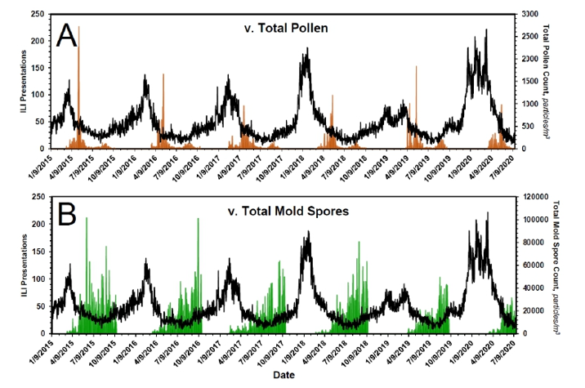
Bioaerosols

Slide 9
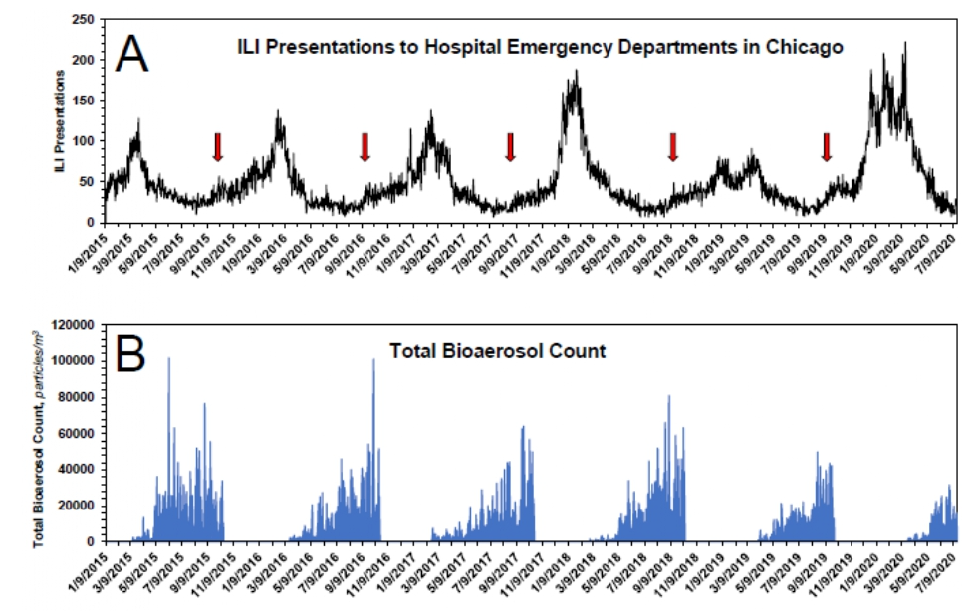
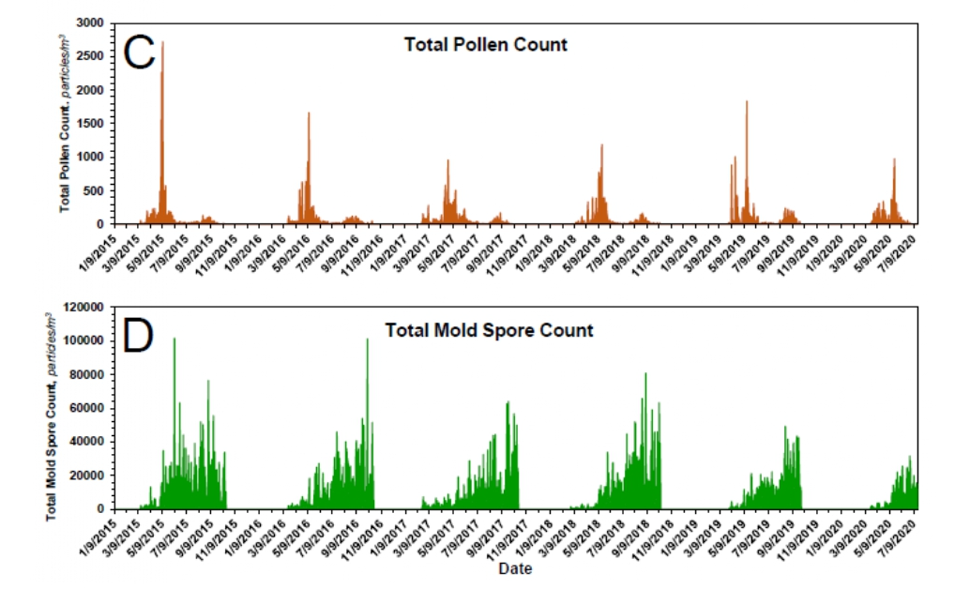
Bioaerosols

Slide 10
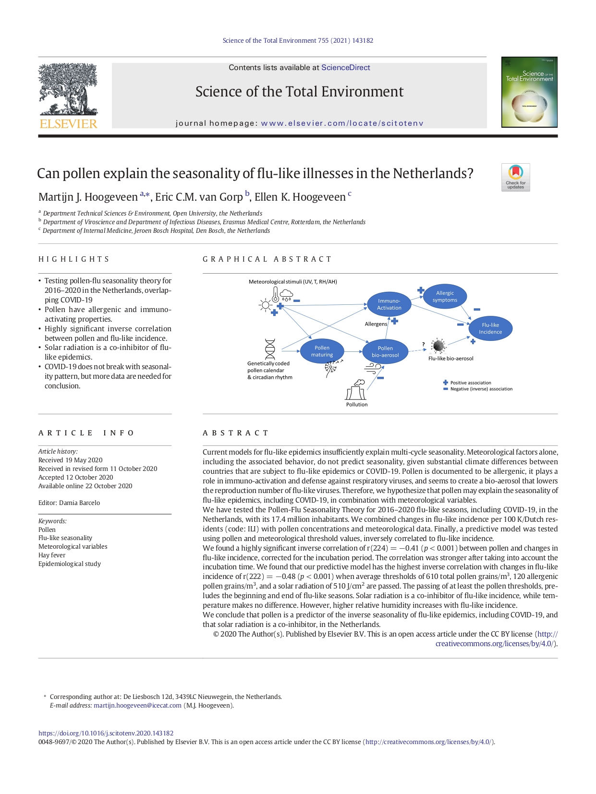
Bioaerosols
Key Studies
Hoogeveen et al. (2021)
Pollen thresholds predict flu-like illness transitions in Netherlands; solar radiation as co-inhibitor.
https://doi.org/10.1016/j.scitotenv.2020.143182

Slide 11
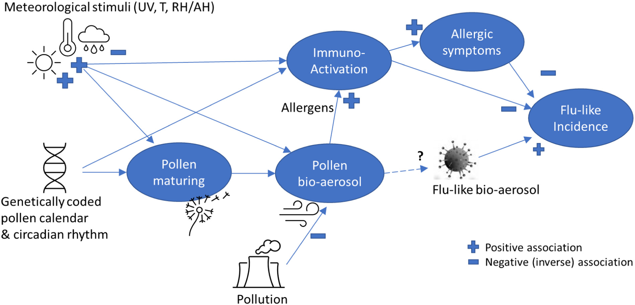
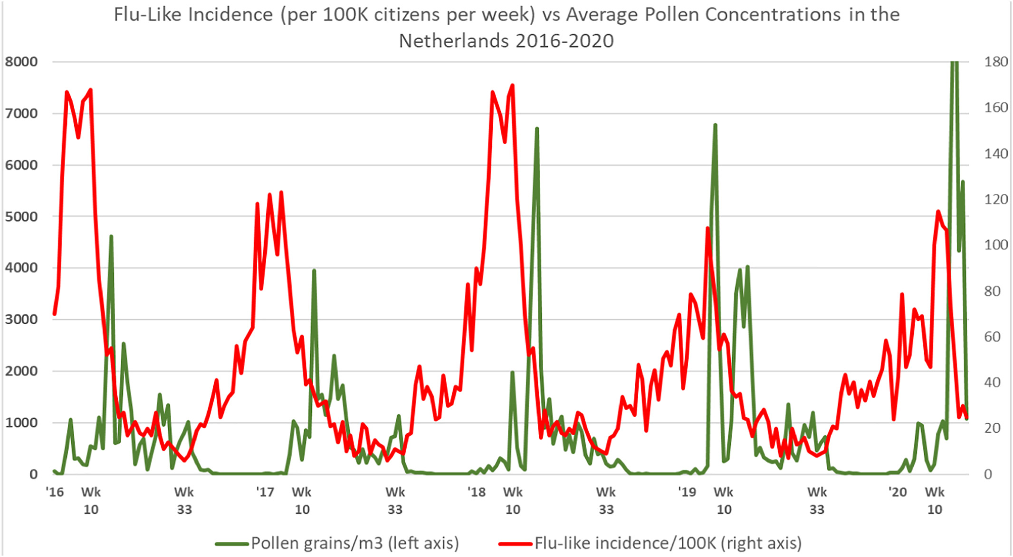
Bioaerosols

Slide 12
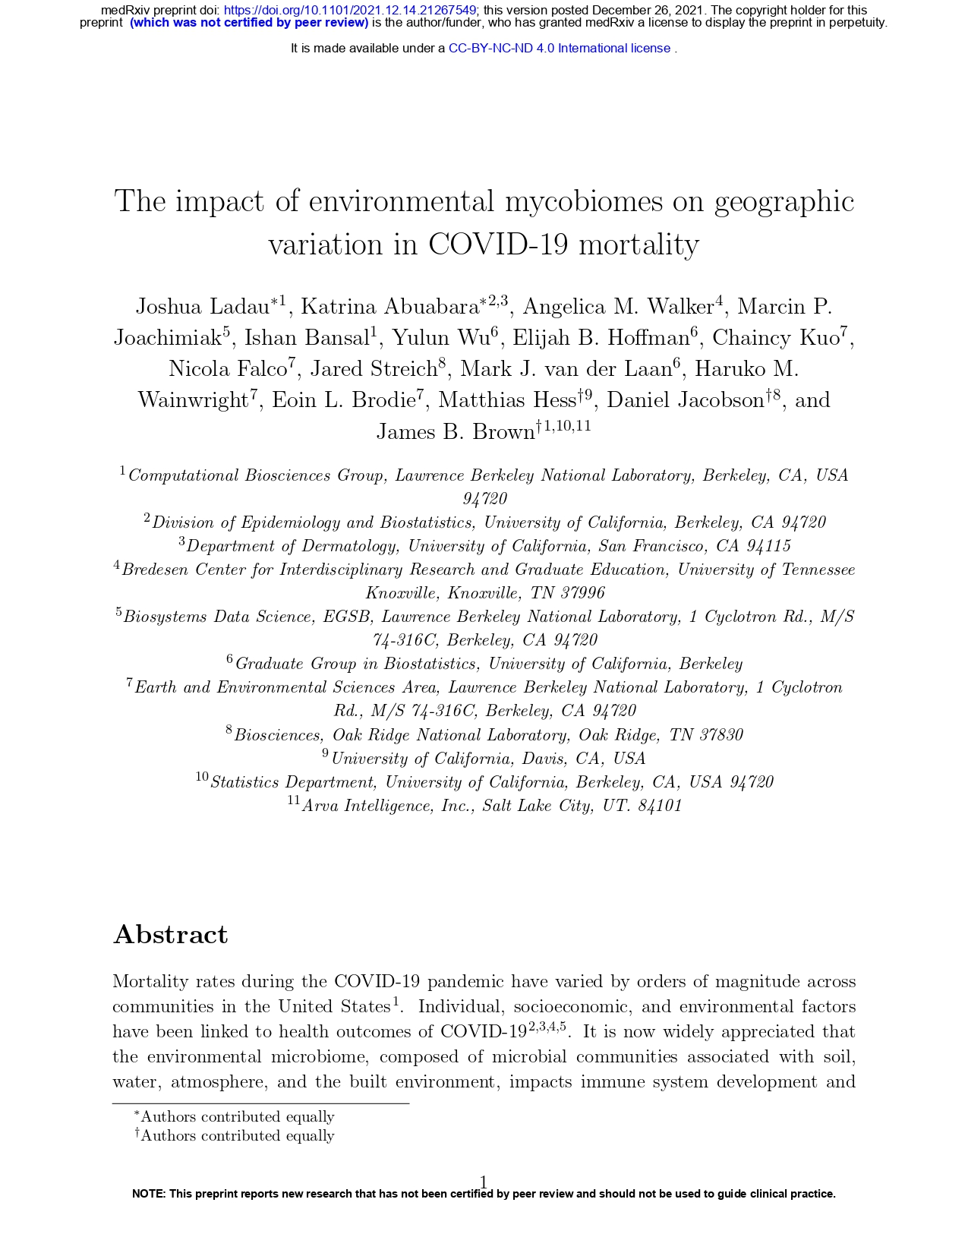
Bioaerosols
Key Studies
Ladau et al. (2021)
Greater indoor-outdoor fungal diversity linked to lower COVID-19 fatality ratios in USA.
https://www.medrxiv.org/content/10.1101/2021.12.14.21267549v2

Slide 13
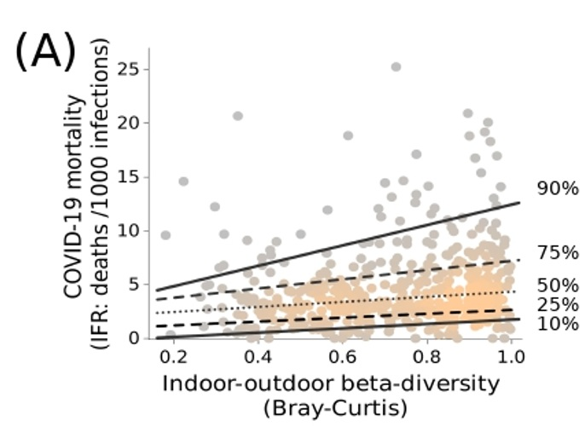
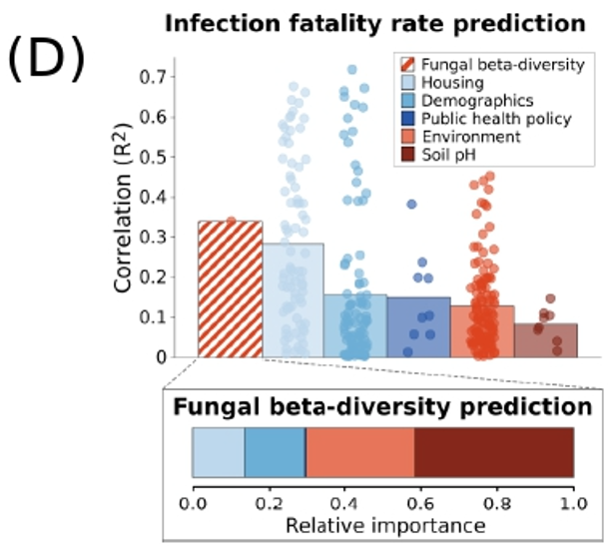
Bioaerosols
“COVID-19 mortality is suppressed in homes where outdoor fungi occur indoors”

Slide 14
Challenge in Australia/Thailand:
Limited real-time mould data;
Can we use other metrics as proxies: like PM_{2.5}/PM₁₀
Fungal contributions: 4-11% of PM_{2.5} mass (per Burshtein et al., 2011; Zhang et al., 2010)

Slide 15
Building on the Original: 2025 Updates

Slide 16
Context of the problem
Climate Extremes & Regional Gaps
Longer pollen seasons, wildfires, water-logged soils after floods leads to altered mould growth (Gu et al., 2024)
Extension to Australia/South-East Asia: hypothesized similar bioaerosol patterns and effects, but mould data is manual/microscopy-based (Jones & Neumeister-Kemp, 2025*)
Solution: Use PM_{2.5}/PM₁₀, pollen, meterological variables (humidity, dew point) as proxies for bioaerosol exposure
Infodemiology integration: Google Trends for ILI proxies (e.g. “fever”, “cough”) predicts outbreaks (Porcu et al., 2023; Shih et al., 2024; Chu et al., 2025).
* https://doi.org/10.15406/jbmoa.2025.13.00402

Slide 17
Proposal
Conceptual Framework
Bioaerosol Risk Model
Frame PM/pollen as immunomodulatory variables, not just pollutants.
Inverse relationships: High bioaerosol levels, lowers ILI risk via immune priming
Risk stratification: Green (low risk/high bioaerosol), Yellow (moderate), Red (high risk/low bioaerosols).
No new sensors needed: Leverage API’s for scalable forecasting

Slide 18
AI/LLM’s
Methods: Vibe Coding Approach
AI-Assisted Development
Vibe coding: Conversational prompt-driven programming using AI (Sarkar & Drosses, 2025; Sapkota et al., 2025).
Tools: LLM’s (ChatGPT, Claude, Gemini, DeepSeek, Grok, Perplexity)
Platforms: Replit, Lovable, Bolt & Manus for no-code/low-code dashboards
Iterative workflow: Natural language prompts, refine code, integrate real data (avoid synthetic defaults), test, modify, repeat...
No new sensors needed: Leverage API’s for scalable forecasting

Slide 19
API’s
Methods: API Integration
Data Sources
Ambee API: PM_{2.5}, PM₁₀, pollen (tree/grass/weed), temp, humidity, precipitation, wind, NO2, CO
City of Melbourne Open Data: Local PM/weather
OpenWeatherMap: Meterological variables
Google Trends: ILI proxies (fever, cough, sore throat, muscle ache, fatigue)
Enables daily risk profiles using existing sensor networks; real time, AU/Thai ustralia/global cities

Slide 20
Model Parameters
Bioaerosol Classifications
Proxy Calculations and Thresholds
Bioaerosol coefficients: PM_{2.5} (0.024), PM₁₀ (0.048) – Mass fractions of biological particles (Liu et al., 2019; Humbert et al., 2011).
Pollen thresholds (QUT Allergy Research Group)
Iterative refinement: start with raw PM, add coefficients for alternate modelling

Slide 21
Pilot Project
Development & Prototyping Phases
From Concept to Dashboard
Phase 1: Query Melbourne sensors for PM trends, corelate with Google Trends ILI data
Phase 2: Automate aggregation; build UI in Lovable/Replit/Bolt
Validation: manual checks for real vs. synthetic data.
Outputs: Responsive dashboards with risk visualizations.
Phase 3: Extend workflow to include other API’s

Slide 22
MVP Outcome
Results: Key Dashboards
Demonstrated Functionality
Real-time API integration for cities (e.g. Melbourne)
Vibe zone classifications: Green/Yellow/Red (colour/emotion and number/decision) rule based logic on bioaerosols and search trends
Data storage/retrieval in databases
UI for public communication
Google Trends ILI surveillance at State/National levels – other networks

Slide 23
Early Melbourne Results: Inverse bioaerosol-ILI trends; aligns with Victorian Health Reports

Slide 24
IAQ + Sentiment
Hygiene Hypothesis in Action
Melbourne Case Study
PM decline over period correlated with increasing ILI/COVID (Victorian reports)
Google Trends: Rising searches for symptoms
Supports proxy use for forecasting and/or for personalized self-monitoring
Scalable for other cities; valuable where mould data absent

Slide 25
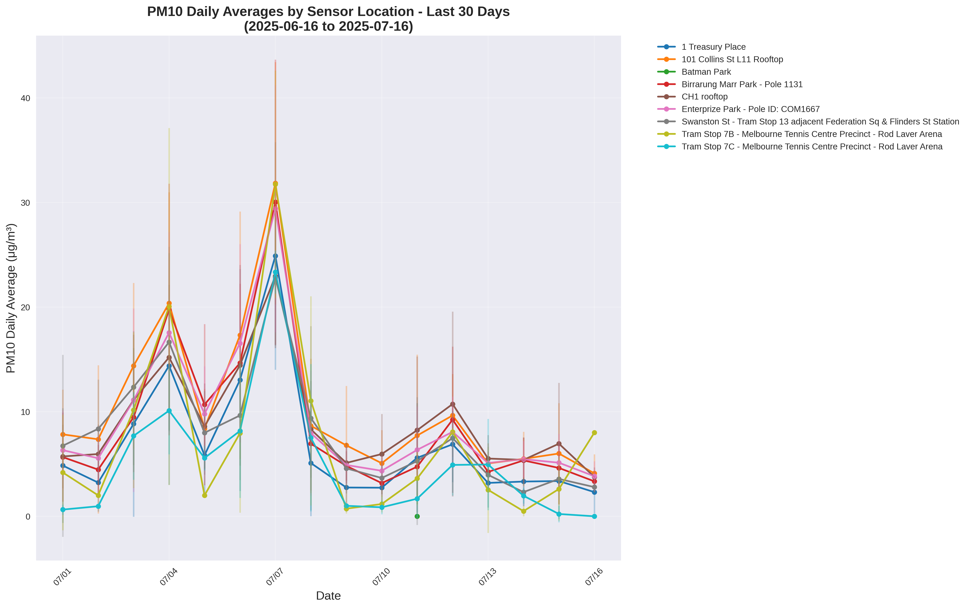
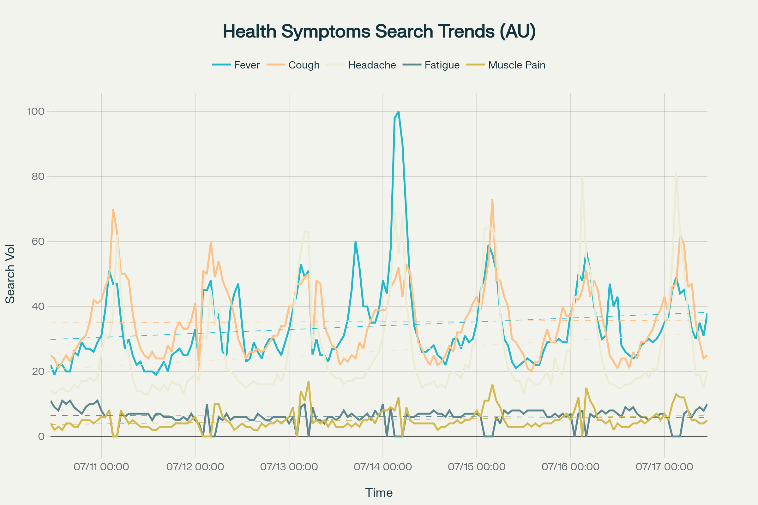
IAQ + Sentiment

Slide 26
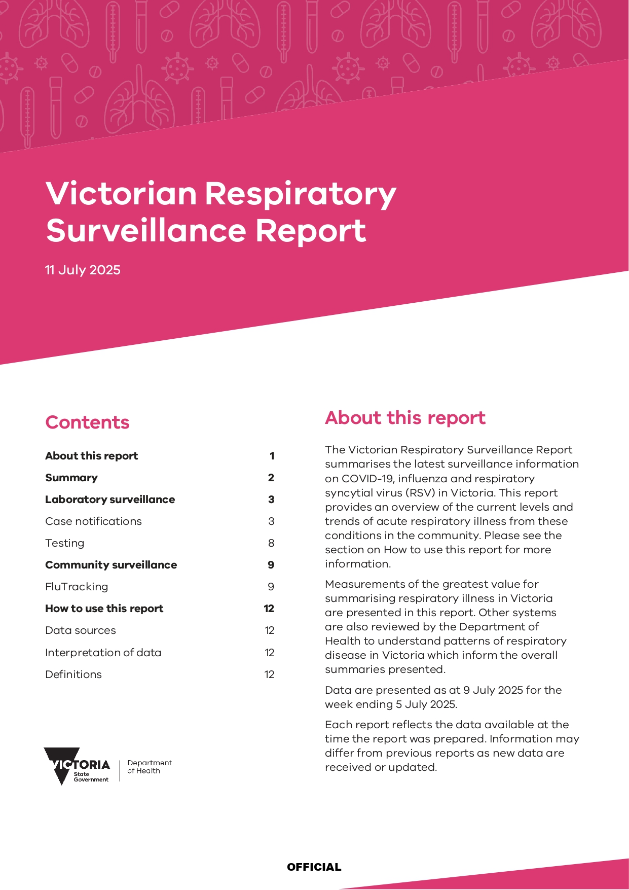
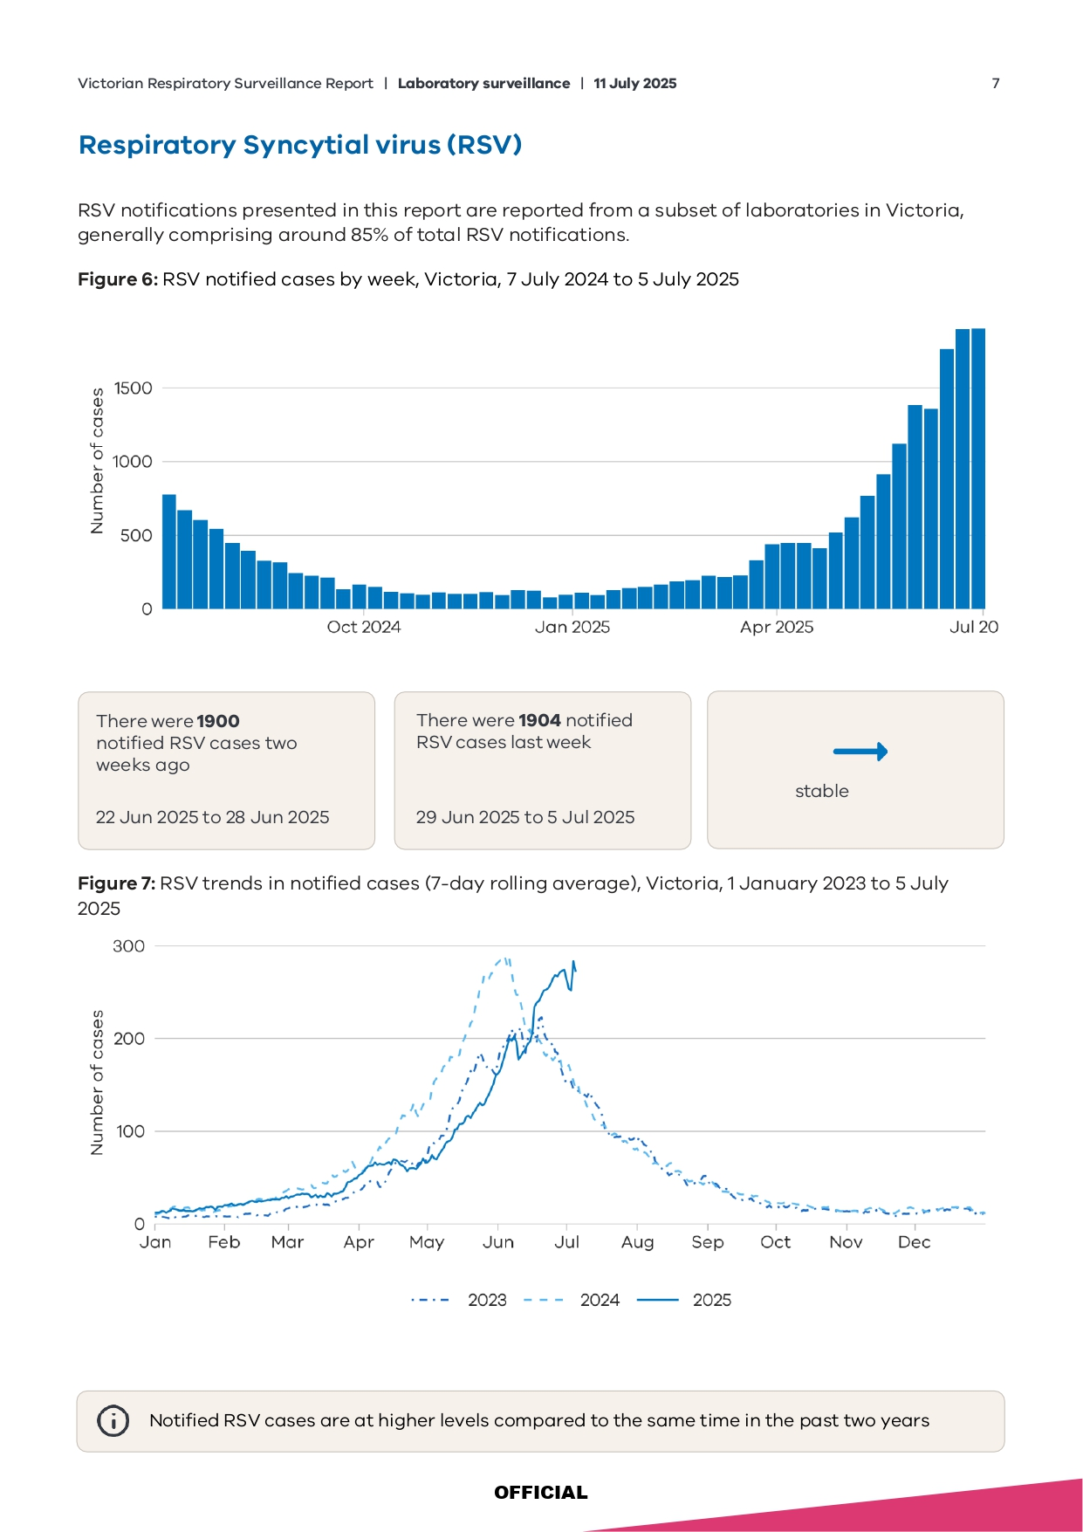
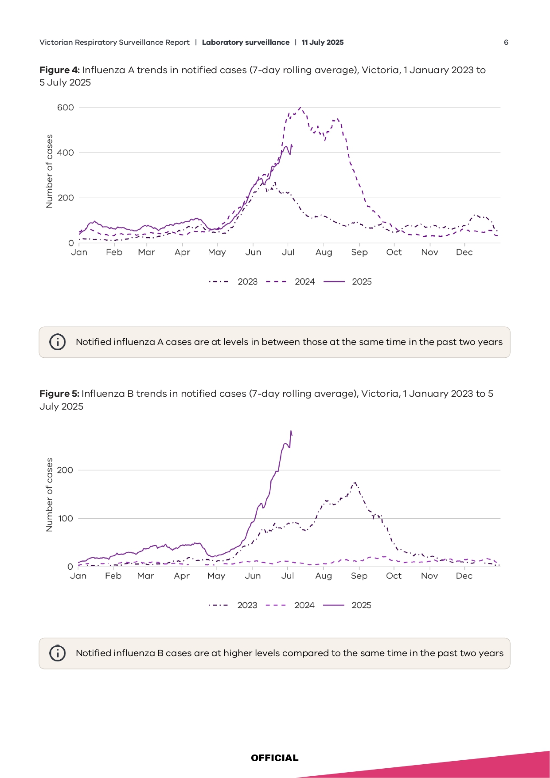
ILI Data Verification

Slide 27
R&D Opportunities
Discussion & Implications
Broader Applications
Accessible tools for researchers/educators/risk data analysts/IEP’s/OccHyg
Regions like Australia/Southeast Asia (Thailand): Need to fill monitoring gaps – pollution metrics (all sources) could become valuable health signals
Future: Enhance with more API’s; refine models for localized events, soil pH, storm/fire, other social network sentiment clustering, IoT in/at the home
Limitations: Proxies not perfect; need validation across hemispheres
Potential: Extend to also include indoor sensor monitoring

Slide 28
Future Looking
Conclusion
Key Takeaways
Evolved from COVID-era inverse correlations in discrete data sets to AI-LLM -driven data aggregation, visualization, forecasting from existing sensors
Vibe coding + public API’s enabled no-new sensor, scalable dashboards
Proxies (PM, pollen) can provide useful/predictive health intelligence
Empowers public health in data-scarce regions/locations
Extensible to Web3 and/or blockchain and DePIN, Solana dApps

Slide 29
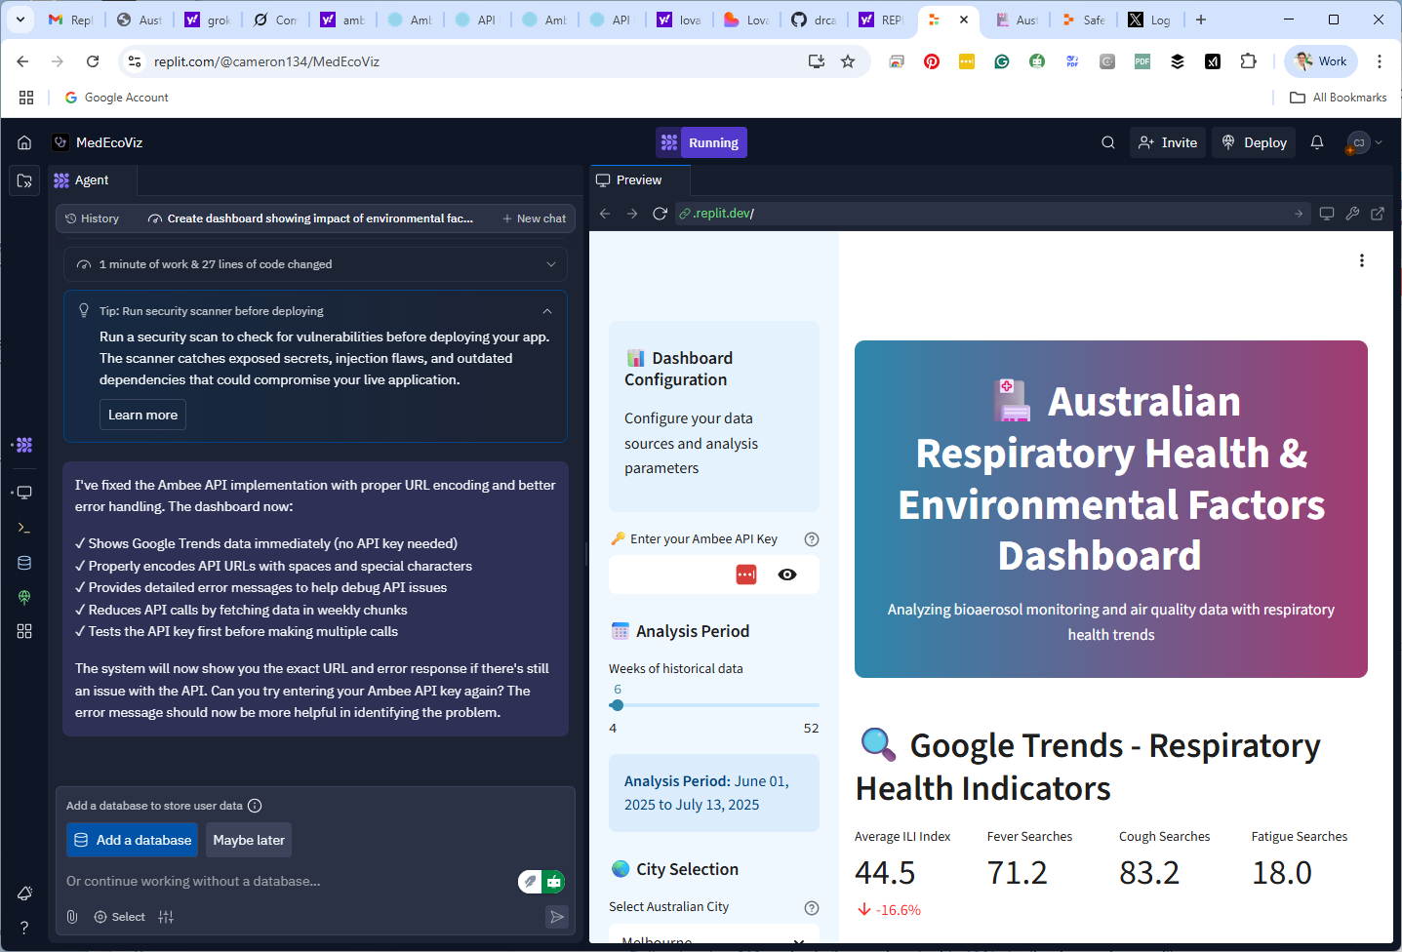
Examples

Slide 30
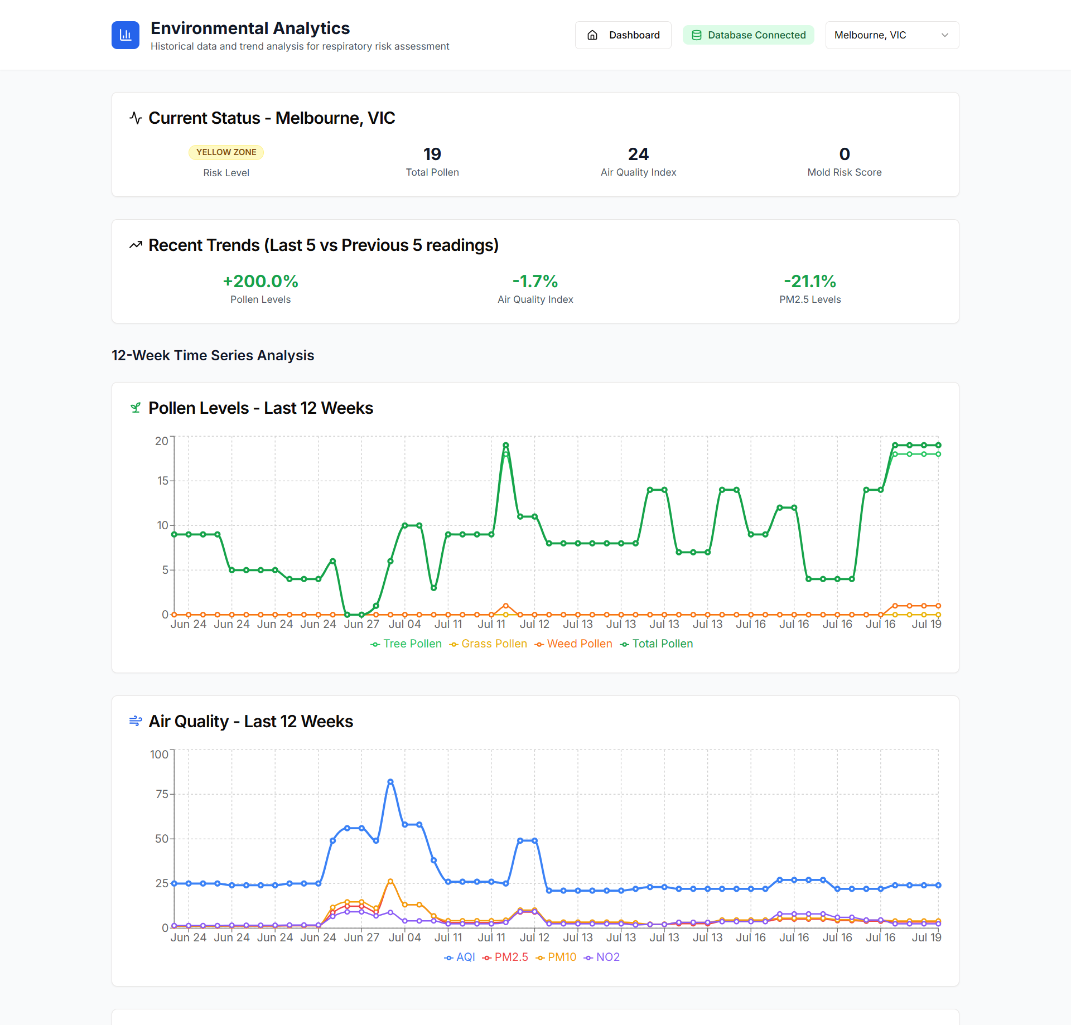
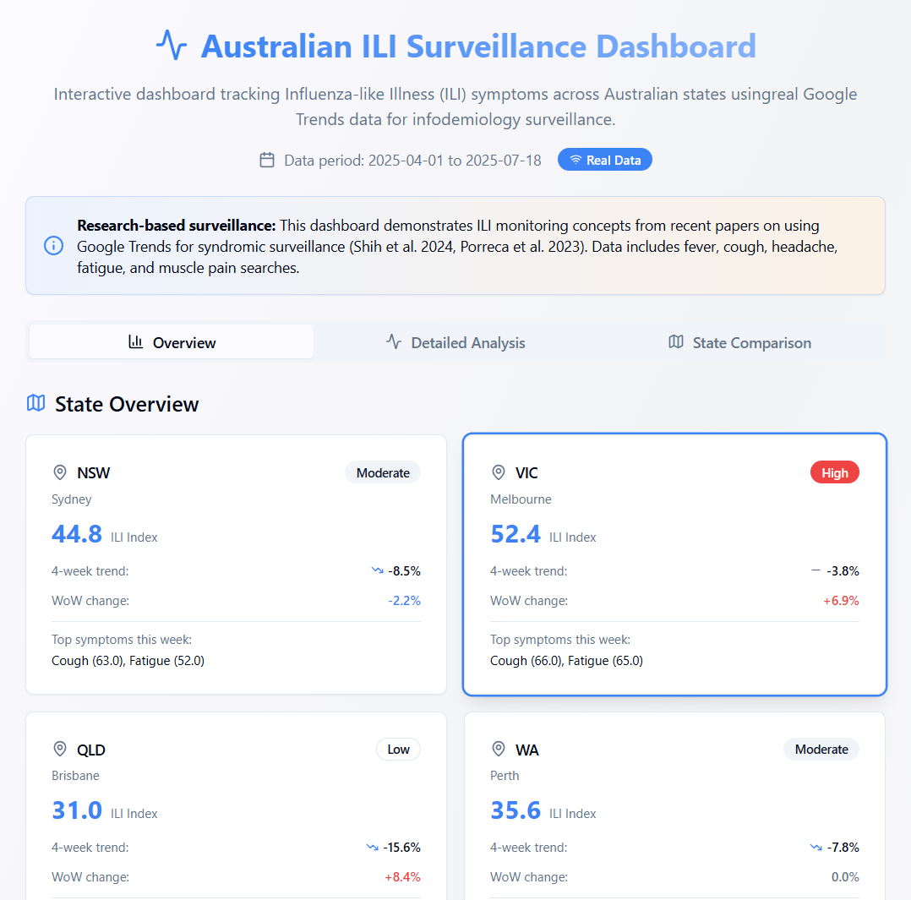
Examples

Slide 31
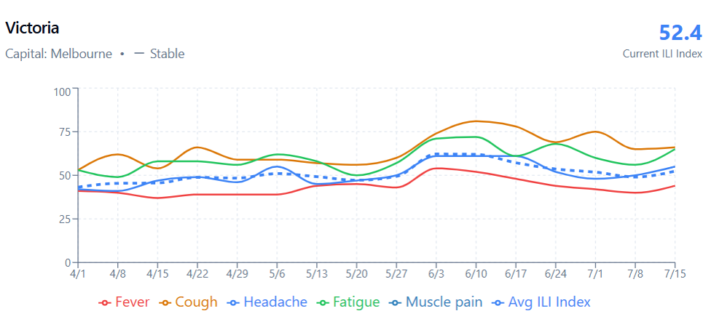
Examples

Slide 32
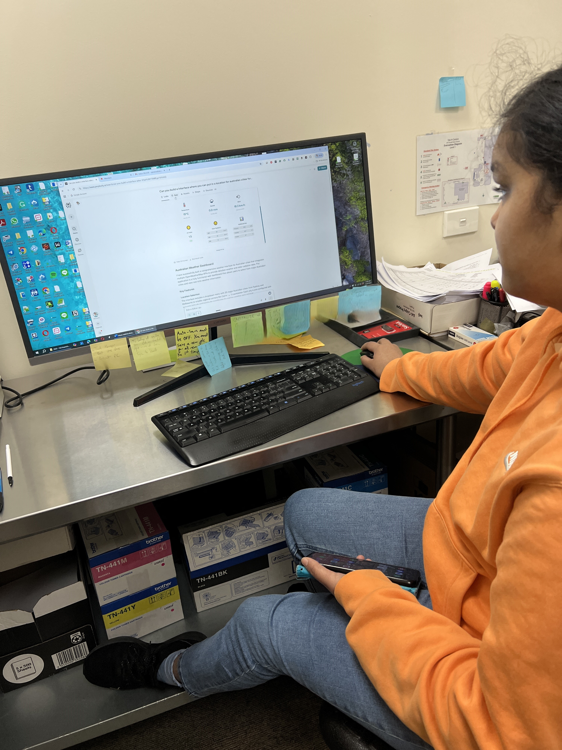
Thank you ☺
Cameron & Bhavya
cameron@drcameronjones.com
Notes:
How could this be personalised and scaled?

